Slide 1
IRP Expansion Round 1 Annual Project Plan & Budget Part 1: Negotiating the annual Project Plan
Guidance for Indigenous Rangers Program Providers

Slide 2
PowerPoint Presentations set up
There are two PowerPoints on negotiating the Annual Project Plan and Budget (APP&B):
Part 1 (this PowerPoint)– Negotiating the Project Plan
Part 2 – Negotiating the Budget

Slide 3
Indigenous Rangers Program (IRP) outcomes
Managing Country at the direction of Traditional Owners / communities.
Intergenerational transfer of cultural knowledge.
First Nations people (including women and youth) gain skills for meaningful employment.
First Nations people transition into specialist positions and leadership roles.
Building economic resilience of Indigenous organisations.
Caring for Country through partnerships with community, government and non-government organisations.
These outcomes are planned and delivered through the Annual Project Plans, actioned by Ranger Teams. Your activities must also be consistent with your project schedule.

Slide 4
What is the Annual Project Plan & Budget (APP&B)
The APP&B is one of the main documents provider organisations use to plan and report on the IRP.
The APP&B outlines approved activities and budgets for each financial year by:
Detailing specific project deliverables (activities)
Breaking down how funding will be used to deliver activities (budget line items)
The APP&B is negotiated with, and approved by, the NIAA.
Once approved by NIAA, the APP&B is used for bi-annual activity and expenditure reporting. This includes the:
Mid-year report (first half of the financial year)
Annual report (whole year)

Slide 5
The Project Plan
The Project Plan is guided by environmental and cultural priorities developed in consultation with Traditional Owners, Elders, Community and other relevant stakeholders.
The Project Plan should:
Be endorsed by Traditional Owners
Reflect Traditional Owners’ aspirations for Country (seek guidance from your Traditional Owner Governance group - Traditional Owner governance meetings may be linked to NIAA site visits
Include all planned activities that will be undertaken during the financial year
Be achievable
Demonstrate progress in managing issues over time by building on the previous year’s work where relevant
Should be described in clear and simple language, including fee-for-service activities.

Slide 6
When is the APP&B negotiated?
The APP&B is negotiated prior to the start of each financial year, during the last quarter (April to June) of the previous financial year.
The APP&B should be approved by NIAA prior to 30 June each year.
Your Agreement Manager will provide you with the APP&B workbook.
When should the APP&B be re-negotiated?
A change in budget or activities, for example:
- Natural disaster
- Where unspent funds are approved for carry-forward into the current year.
How is the APP&B negotiated?
The APP&B can be re-negotiated and approved by an exchange of letters (email approval) with the NIAA delegate.

Slide 7
New IRP Projects funded in 2025
The 2025-26 APP&B will be different from the 2024-25 APP&B:
The 2024-25 APP&B was for a part-year - activities mainly for setting up your ranger group
2025-26 APP&B is for a full year
The 2025-26 APP&B includes employee planning and reporting.
If you are unsure, check with your Agreement Manger to make sure you have the right template.
Do not include activities for your Indigenous Protected Area (IPA) Project or other IRP projects in the APP&B for your new IRP Project. If you have an IPA or other Ranger projects, you must complete a separate APP&B for these projects.
IPAs will have a different APP&B workbook for 2025-26. This workbook will be very similar to the IRP worksheet, but not the same. Please note the differences when completing and reporting.
Contact your Agreement Manager if you are unsure which APP&B to use for each of your projects.

Slide 8
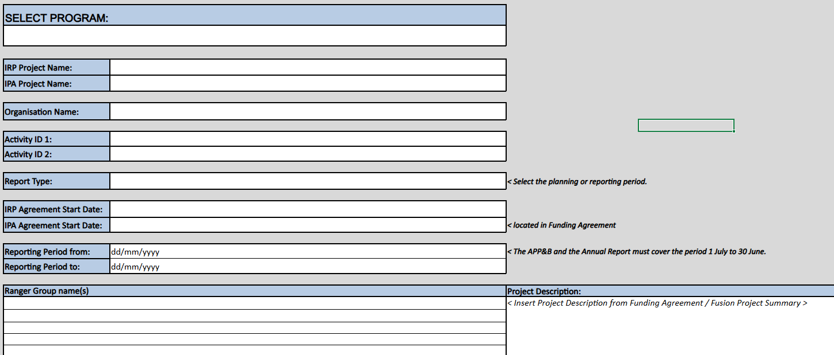
Step 1 – Complete the Report Type Worksheet
Fill out your:
Project Name
Your Organisation Name
Activity ID
Report Type
Project Start Date
Reporting Period dates
Your Ranger Group Name
Your Project Description

Slide 9
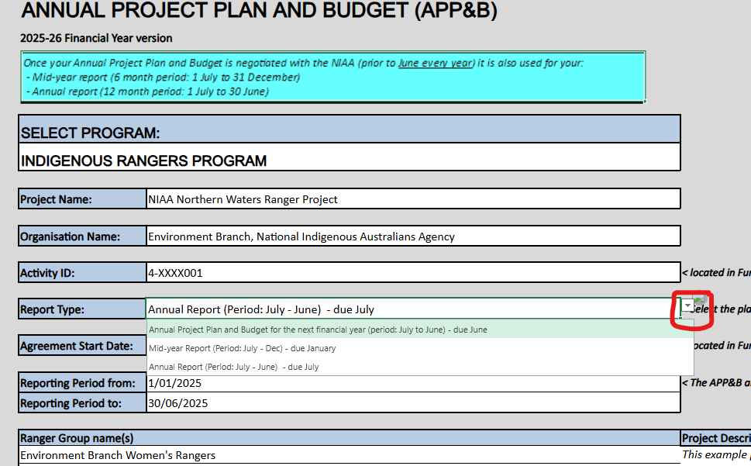
Choose the report you are completing
The options are:
Annual Project Plan and Budget
Mid-Year Report
Annual Report

Slide 10
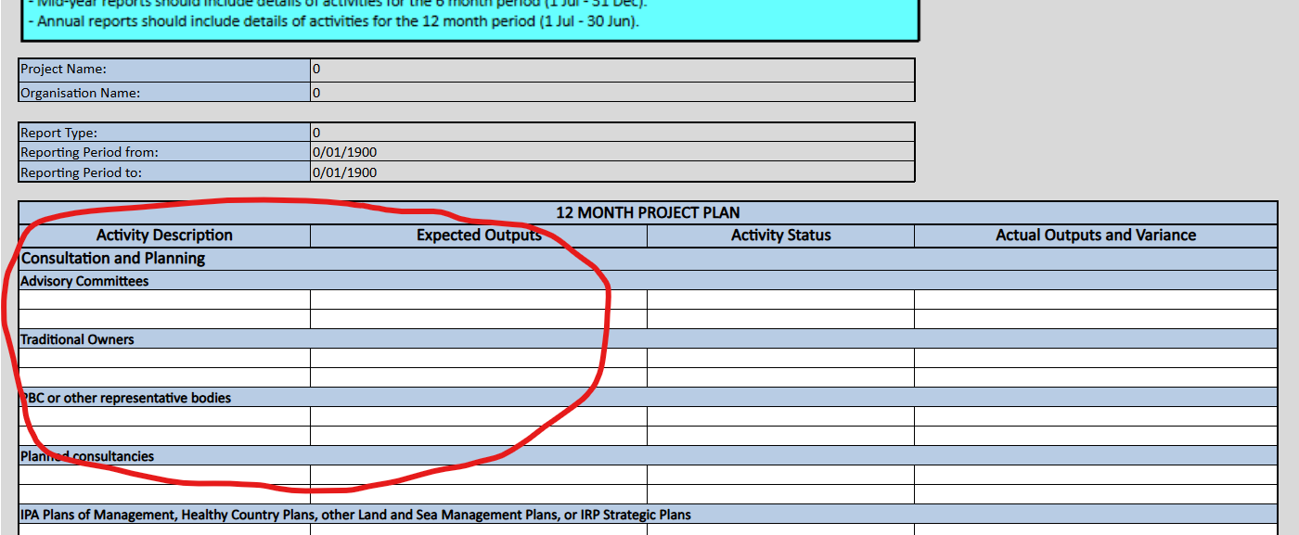
Step 2 – Complete your Project Plan

Slide 11
Step 2a – Writing your Activity Description
The Activity Description column should list and describe each of your planned activities. All planned activities should align with your funding agreement and the objectives of the IRP. Each activity should work towards a particular goal or outcome.
You should consider including the following information in your activity descriptions:
The purpose or intended goal or outcome of the activity.
How your rangers or staff will deliver the activity.
If the planned activity is the result of consultation with Elders and Traditional Owners, taken from strategic planning documents), or in partnership with another organisation etc.

Slide 12
Activity description
Tip: try not to mix activities where possible. Consider splitting activities to cover different locations, different species, different sites etc.
Example:
Try not to group weed and animal management activities – different species should be given their own rows.
Fire activities – permitting, training and burning should all have their own rows.
Cultural management activities – describe management of each site in their own rows. Some activities as a particular site may also require its own row

Slide 13
Step 2b – Writing your Expected Outputs
An Expected Output is the results you expect to achieve from a particular activity. You can have multiple Expected Outputs listed against one Activity Description.
When writing your Expected Output descriptions, include the following information, where possible:
The number of rangers required to deliver or undertake the activity
The location where the activity will be delivered.
Try to be as specific as possible when identifying the location of your planned activity.
The expected timeframe this activity will occur.
Timeframes can be:
Describing a period in which the activity will occur e.g. management of x weed species, in the month prior to when it seeds in September
Describing how long the activity will take e.g. a week to deliver weed management over x hectares
Specific dates, where these are known.
the timeframe for Expected Outputs must be within the financial year.
Something you can measure:
This can be the number of hectares of weed control, planting a specific number and type of a native plant species or the number and species of pest animals you plan to remove.

Slide 14
Step 3 – Outcomes vs Activities, vs Outputs
Outcomes (The way something will turn out, a vision statement or goal) | Activities (An action to deliver the outcome) | Outputs (Something produced, what results do you expect from the activities?)
Example: Cultural sites are maintained in accordance with Traditional Owners’ expectations. | Examples of relevant activities: (these may be in different areas of the Project Plan) Hold meetings of [group name] to prioritise actions for [site name]. Remove [pest plant name] around [site name]. Conduct cultural or hazard reduction burns to protect [site name] from wildfire. Erect fencing or signage around [site name]. | Examples: Meeting dates X Number of Hectares of weeds sprayed Publishing a plan Producing a map Constructing x km of fencing Construct x number of signs (photographs)

Slide 15
Activities may continue across multiple years
For ongoing activities spanning several financial years, at the beginning of each financial year:
Update the Activity Description or Expected Output description to reflect any new expected results.
Ensure you indicate where activities follow on from previous financial year activities.

Slide 16
USE S.M.A.R.T when writing your Activity Descriptions and Expected Outputs
S.M.A.R.T. | Explanation | Example
Specific | State exactly what the activity is and how and where it will be done | ☑‘Hold an information session at the visitor centre on bush tucker and tree planning for First Nations youth from X township. ☒ ‘Hold a community education session’
Measurable | Provide a numerical value by which you will measure how completed the activity is. | ☑’Remove marine debris along 30km of coastline, starting from Southside Beach.’ ☒’If possible, perform beach clean ups’
Attainable | Your activities and expected outputs should be realistic and achievable within your estimated time-frame and planned budget. | ☑’Participate in at least one fish survey in the XX River with the XX Department ☒’Participate in five fish surveys with the XX Department each month
Relevant | The activity should contribute to the goals and outcomes of the IRP, MDBIRR or IPA programs. | ☑’Undertake aerial spraying of Mimosa (Weed of National Significance)’ ☒’Build community arts centre extension’
Time Bound | Provide a realistic timeframe or deadline for planned activities | ☑’Conduct ten days of patch burning on sandplain Country in April-September’ ☒’Complete patch burning activity’

Slide 17
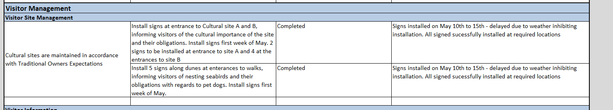
Example:
Project Plan –Activity Description and Expected Outputs
Activity Report – Activity Status and Actual Outputs and Variance

Slide 18
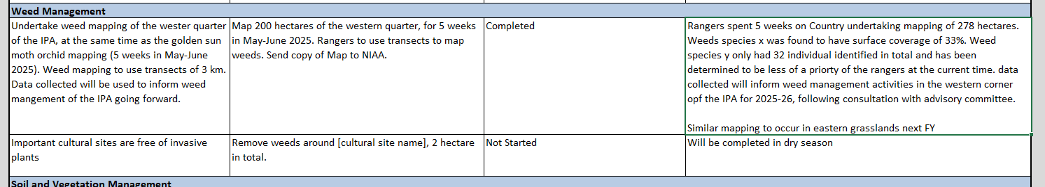
Example:
Project Plan –Activity Description and Expected Outputs
Activity Report – Activity Status and Actual Outputs and Variance

Slide 19
Approval of high-risk activities
Ranger activities are commercial in nature and relevant state, territory and/or Commonwealth workplace health and safety regulations apply.
Some activities may require evidence of approval by a statutory authority before they can be approved by the NIAA. Examples include:
Working with children or vulnerable people
Lighting fires for cultural or hazard reduction burns
Acquiring or operating vessels
Diving and snorkeling activities
Acquiring, storing and operating firearms
Operating drones
Operating some types of machinery
Handling wildlife for conservation/rehabilitation work (no hunting wildlife).
Where a provider doesn’t have approval, the activity which should be included in the APP&B will be about getting that approval. For example, accredited training, developing managing systems, negotiating permits.

Slide 20
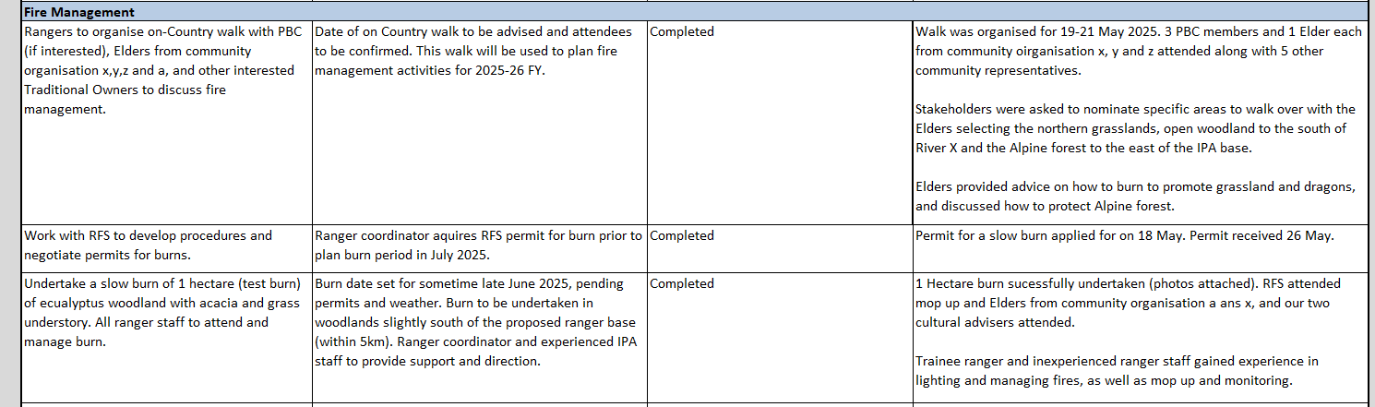
Example:
Project Plan –Activity Description and Expected Outputs
Activity Report – Activity Status and Actual Outputs and Variance

Slide 21
Commercial activities
Commercial activities and fee-for-service activities delivered by IRP funded employees, or assets, must be approved by the NIAA via the Project Plan.
Commercial activities can include:
Livestock (cattle, buffalo)
Tourism
Carbon abatement
Other business activities that generate income
FEE FOR SERVICE
Fee-for-service means the delivery of services for payment. You will be asked to report the amount of income you earned form these activities but you are not required to acquit this income as it is not considered project generated income.
PROJECT GENERATED INCOME (PGI)
PGI means any income derived from the grant, including but not limited to, interest, the appreciated value of assets/land, insurance and dividends but does not include Fee-for-Service Income. To avoid any doubt, PGI forms part of the grant under the Project Agreement.

Slide 22
Describing assets in the Project Plan
Asset leases, purchases and disposals must be approved by the NIAA.
Assets are items with an initial cost of $5,000 (GST exclusive) or more.
Finance leases and fixed term leases must be approved by NIAA.
You must maintain an ongoing asset register (included in the APP&B template).
The NIAA registers an interests in assets such as vehicles and vessels on the National Personal Property Security Register (PPSR)

Slide 23
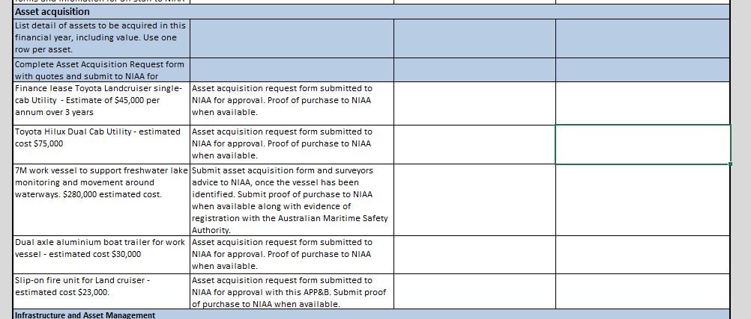
Example: describing assets in the Project Plan

