Slide 1
Presentation to Ranger Groups
Indigenous Rangers Program
Expansion Round 1
NIAA – Corporate and Commercial Law Team
31 March 2024

Slide 2
Today’s presentation
      Legal aspects of the Rangers Program funding.
      What documents are we talking about?
      What will we discuss today?
      Please ask questions!

Slide 3
What is a grant?
A grant is an arrangement where the Commonwealth provides financial assistance:
under which relevant money / other CRF money is paid to a grantee, and
helps address the Government’s policy outcomes while assisting the grantee achieve its objectives.

Slide 4
About
The Indigenous Rangers Program funds the management of Country according to Traditional Owner objectives. Rangers use traditional knowledge, cultural practices, and Western science to manage land, river and sea Country and deliver environmental, cultural, social and economic development outcomes.
Through the Rangers Program, the Commonwealth acknowledges and supports First Nations peoples’ unique, critical and continuing role to manage and protect natural and cultural heritage.
The government expanded the Rangers Program via a grant opportunity.
Funded groups deliver on Country activities including:
engaging with community and Traditional Owners to plan land and water management activities
fire management - cultural burning and bushfire mitigation – biosecurity management
biodiversity conservation - habitat and threatened species management, invasive species management, freshwater and sea Country management
cultural heritage protection, maintenance, intergenerational knowledge language and culture transfer
partnerships with research, education, philanthropic and commercial organisations

Slide 5
What are the key documents and why?
Grant Opportunity Guidelines
Head Agreement (Deed)
Project Schedule (Contract)
Additional Conditions

Slide 6
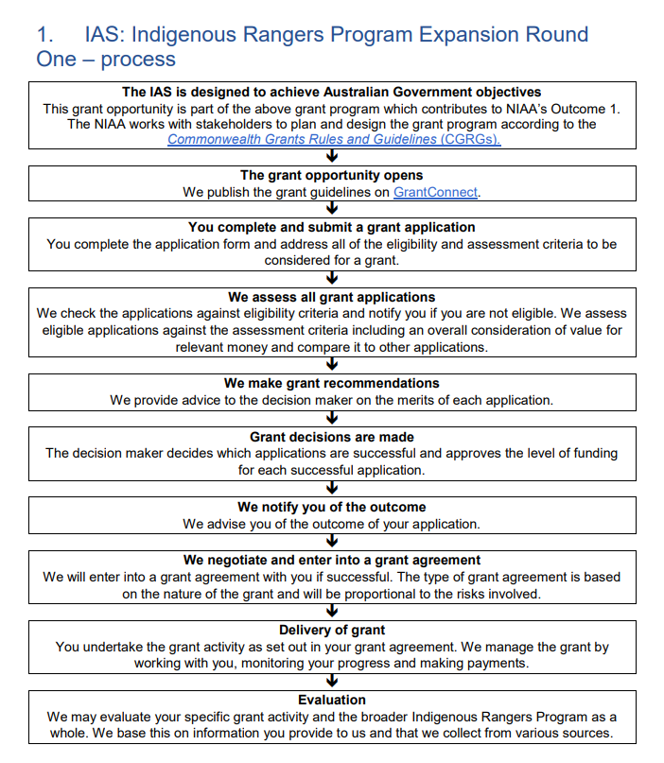
6

Slide 7
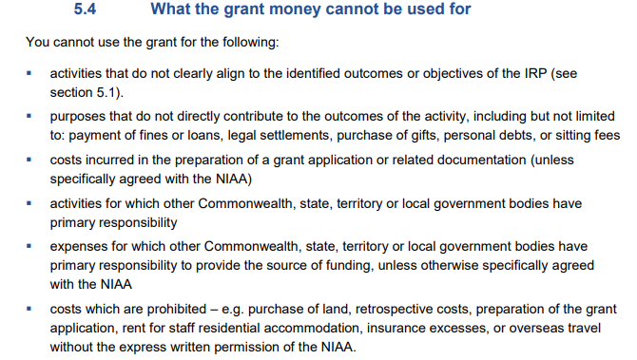

Slide 8
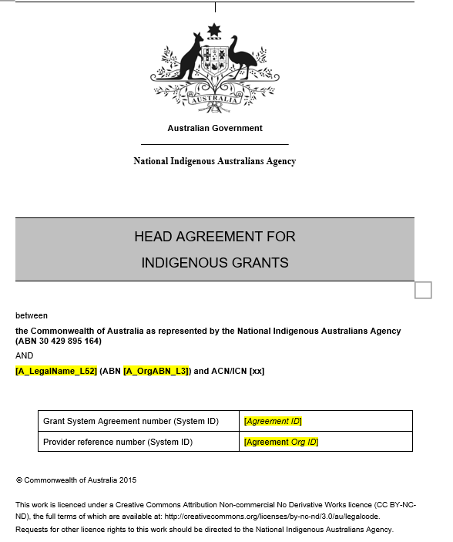
Head Agreement

Slide 9
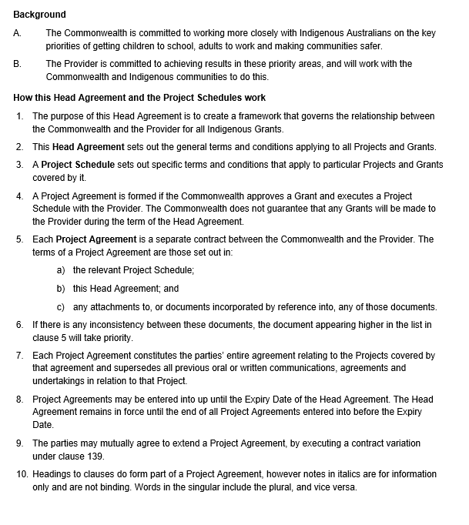

Slide 10
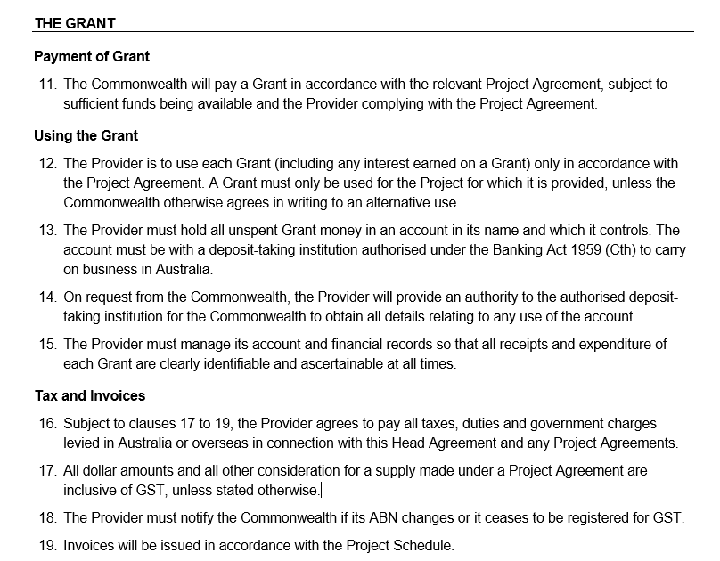

Slide 11
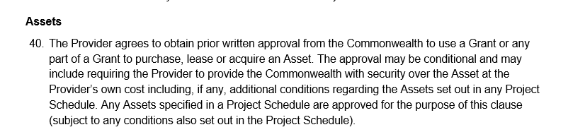
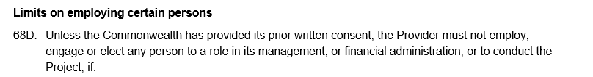
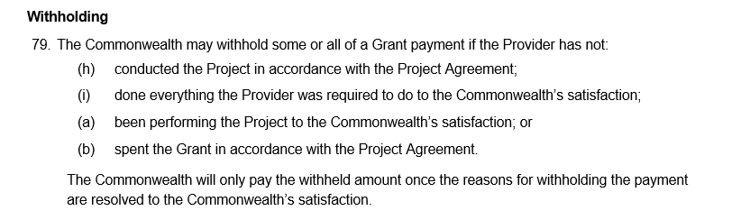

Slide 12
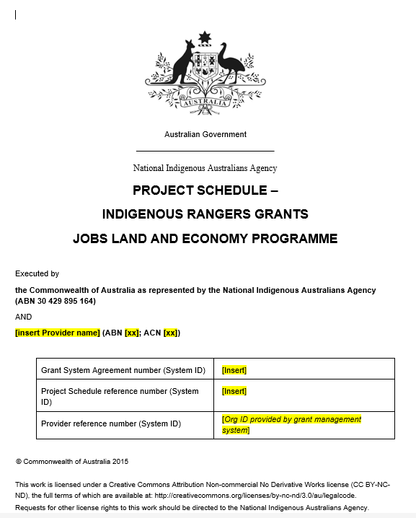

Slide 13
Key parts – Project Schedule
Milestones
Deliverables
Payments – generally when a milestone is met –payment triggered
Agreement Start Date and End Date
Project Start Date and End Date
Variations

Slide 14
Head Agreements, Project Schedules, MOUs
IAS Head Agreement: clauses 1 – 10 set out the general architecture, structure and hierarchy of Project Agreements.
Head Agreement: general terms & conditions applying to all grants
Project Schedule: specific terms & conditions of a grant
Together: Project Agreement
Project Schedule takes priority over the Head Agreement, to the extent of any inconsistency
Head Agreement remains in force until the end of all Project Agreements entered into before the Expiry Date
Notes:
Clauses we often advise on are: subcontracting and assignment (clauses 32-36D), assets (clauses 40-47), access (clauses 59-63), withholding and unspent funds (clauses 79-81), breach (clause 82-87), termination for default (clauses 88-91), termination with costs (clauses 92-97), privacy (clause 111) and debts (clauses 126-130).
I’ll be talking about many of the clauses in the Head Agreement today. I’m also happy to take your specific questions either as they come up, later today or tomorrow.

Slide 15
How can you change an agreement?
Obligations and entitlements under a Project Agreement can be varied or transferred from a provider to a third party.
The Head Agreement outlines how these can occur.
139. The Head Agreement and any Project Agreements may only be varied in writing, signed by both parties.
33A. The Provider must not subcontract any aspect of a Project, including any Material Subcontractor, without the Commonwealth’s prior written approval. The approval may be subject to conditions. Any subcontracting arrangements specified in a Project Schedule are approved for the purpose of this clause (subject to any conditions also set out in the Project Schedule).
Other options:
Assignments
Novations
But this requires due diligence – consider the need for new ORPs and ARAs
Notes:
Large numbers of subcontractors may create an administrative burden on both the provider and the Commonwealth (because the NIAA must approve all subcontractors). If this is the case, reach out to us and we can draft you a tailored clause (for example, a reduced threshold for approval).
Under a novation, all of the rights and obligations of one party are transferred to a third party by way of a replacement contract. Under an assignment, usually only some of the rights of one party are transferred to a third party.

Slide 16
Privacy 101: Personal Information and APPs
The NIAA must protect the privacy of personal information it holds in accordance with the Australian Privacy Principles under the Privacy Act 1988 (Privacy Act).
‘Personal information’ means information or an opinion about an identified individual, or an individual who is reasonably identifiable, whether it is true or in a recorded form.
‘Sensitive information’ is a subset of personal information and includes information or an opinion about an individual.
Australian Privacy Principles - Common APPs that come up in our everyday work:
    APP 3 - 5 Collection of personal information
    APP 6 Use or disclosure of personal information
    APP 10 Quality of personal information
    APP 11 Security of personal information
Notes:
Personal information is a broad concept and includes any information or opinion about an identified individual, or an individual who is reasonably identifiable – whether the information is true or not and whether it is recorded in a material form or not.
Sensitive information is a subset or type of personal information and includes information about a person’s racial or ethnic origin (eg indigeneity), political opinions, religious beliefs or affiliations, philosophical beliefs, health information, sexual orientation and criminal record.
All sensitive information is personal information but not all personal information is sensitive information. We will only refer specifically to sensitive information where it attracts specific requirements.
Ask audience to provide examples of personal information. Highlight that sensitive information includes indigeneity which is often collected by the Agency.
APPS- The Privacy Act includes 13 Australian Privacy Principles (APPs) which set out requirements for how to protect personal information. They broadly relate to how personal information is to be collected, used/disclosed and otherwise handled.
Main ones that are relevant to everyday work:
APPs 3-5 Collection of Personal Information:
PI can be collected where the collection is related to the entities functions/duties.
Individuals must be made aware of the collection through a collection notice, this will deal what is being collected, purpose of use, disclosures and how they can make a privacy complaint.
Collecting sensitive information requires consent.
APP 6 – Use and disclosure of personal information
-PI can be used/disclosed for the purpose for which it was collected.
-It can be used or disclosed for a related purpose where:
-the person consents, or
-certain criteria is met such as the person would reasonably expect the information to be used or disclosed for that purpose and the purpose is --related or directly related (sensitive information) to the primary purpose.
APP 10- quality
-Must take reasonable steps to ensure the PI being used or disclosed accurate, up-to-date, complete and relevant.
-Do not use any incorrect or irrelevant information
-Do not change a record - make a record to keep with original noting the need for update and notify manager
APP 11
-Must protect information from misuse, interference, loss, unauthorised access, unauthorised modification and unauthorised disclosure
-Working practices must be secure and robust – this is a particularly important issue to consider when working outside of an NIAA office environment.
-Leads to data breaches

Slide 17
Important resources
Public Governance, Performance and Accountability Act
Public Governance, Performance and Accountability Rule (es8)
Australian Government Grants – Briefing, Reporting, Evaluating and Election Commitments (RMG 412)
NIAA Accountable Authority Instructions
PGPA Act Flipchart
IAS Head Agreement
Federal Register of Legislation - Commonwealth Grants Rules and Principles 2024

